Slide 1
Raspberry Pi Day
3/2/24

Slide 2
Ice Breaker
Introductions (instructors and mentors)
Goals for Today…
Get excited, learn about single board computers (SBC) - namely, Raspberry Pi (RPi).
What is RPi?
How are they used?
How much do they cost $ ?
Demystify Arduino versus Raspberry Pi
Learn about enabling the technologies…
Linux operating system, IoT (Internet-of-things), Basic electronics,
Programming (Python and JavaScript)
Making hardware and software talk with network protocols: MQTT and WebSockets
Complete a hands-on project
Construct a custom IoT Device from scratch
Use Raspberry Pi 3b to build a “Smart” (IoT) lamp

Slide 3
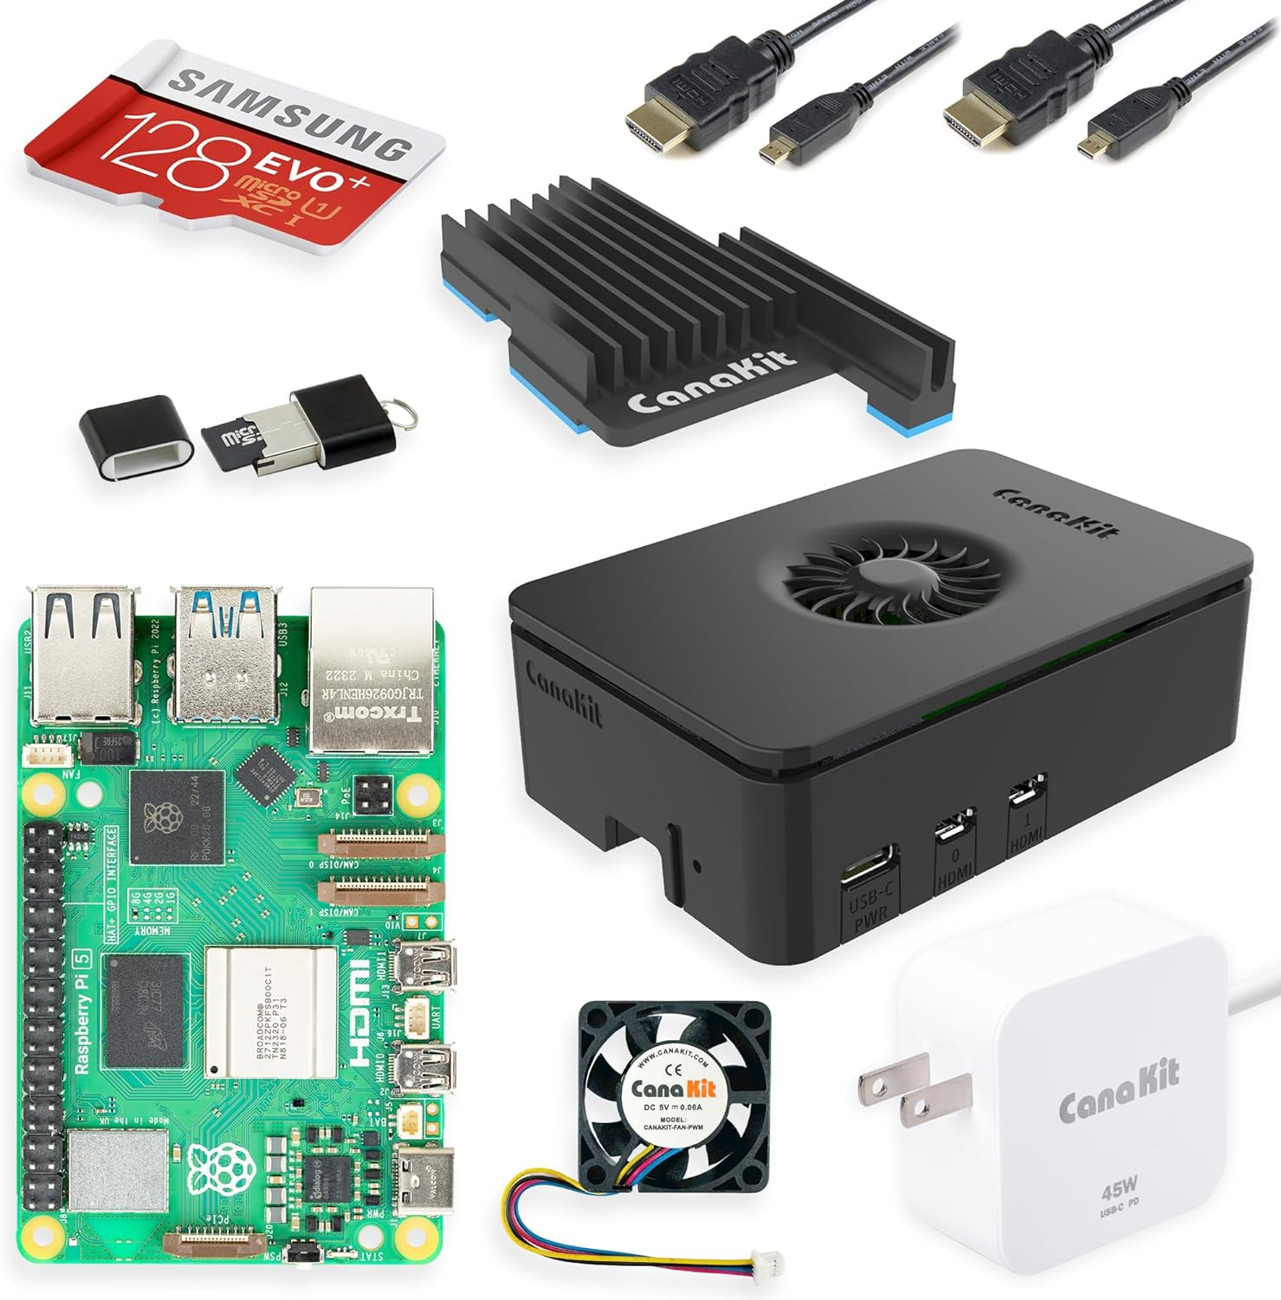
Drawing at 2:45pm today
All camper’s names entered in a drawing for chance to a latest Raspberry Pi 5
Raspberry Pi 5 Starter Kit PRO - Turbine Black (128GB Edition) (8GB RAM)

Slide 4




Agenda and Schedule
Today (9AM – 3PM)
AM
9:00-9:45
Introductions
Griffiss Institute Welcome and Safety Brief
AFRL – Information Directorate Welcome
Background and Enabling Technologies
9:45-12:00 : “Smart” IoT Light Bulb Prototype
9:45-10:45 : Module 1: Provisioning the Raspberry Pi for Use
10:45-11:00 -- Break (restrooms, stretch, questions)
11:00-12:00 : Module 2: Construct the Smart Lamp Device
PM
12:00-1:00PM : Lunch and Demo
12:30 – 1:00 : Special Demo (by Ruben) “IP Phones Enabled by Raspberry PI running PBX software“
1:00-2:00 : Module 3: Implementing the Software (Front-end and Back-end Code)
2:00-2:20 : Challenge Questions
2:20-2:45: Team Demos : (5 min each)
2:45-3:00: Wrap up : (issue certificates, Raspberry 5 drawing

Slide 5
Student Teams –Pick team name (Air Force Aircraft Theme)
F-15 Eagle,
F-16 Fighting Falcon,
A-10 Warthog, C-17
Globemaster,
KC-46 Pegasus,
B-52 Stratofortress
Pick a team representative

Slide 6
Background and Enabling Technologies
What is a Raspberry PI?
https://www.youtube.com/watch?v=eZ74x6dVYes
Pi board comparison: https://socialcompare.com/en/comparison/raspberrypi-models-comparison
Uses?
industrial automation
applications for prototyping
embedded systems
low-cost process controller
Home automation
DIY, education
Raspberry Pi versus Arduino
https://www.youtube.com/watch?v=p40OetppIDg
https://webbylab.com/blog/arduino-vs-raspberry-pi-key-differences-comparison-table/
Raspberry Pi 5 (latest version)
https://www.raspberrypi.com/news/introducing-raspberry-pi-5/
What is Internet-of-things (IoT) all about anyway
https://www.youtube.com/watch?v=6mBO2vqLv38

Slide 7

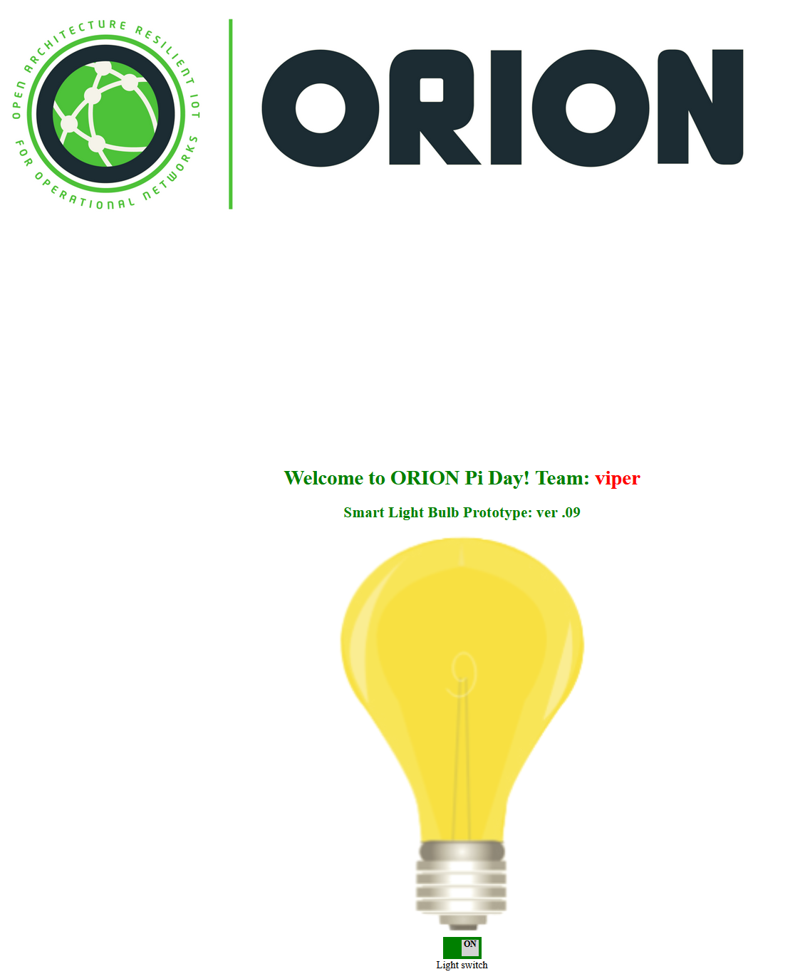

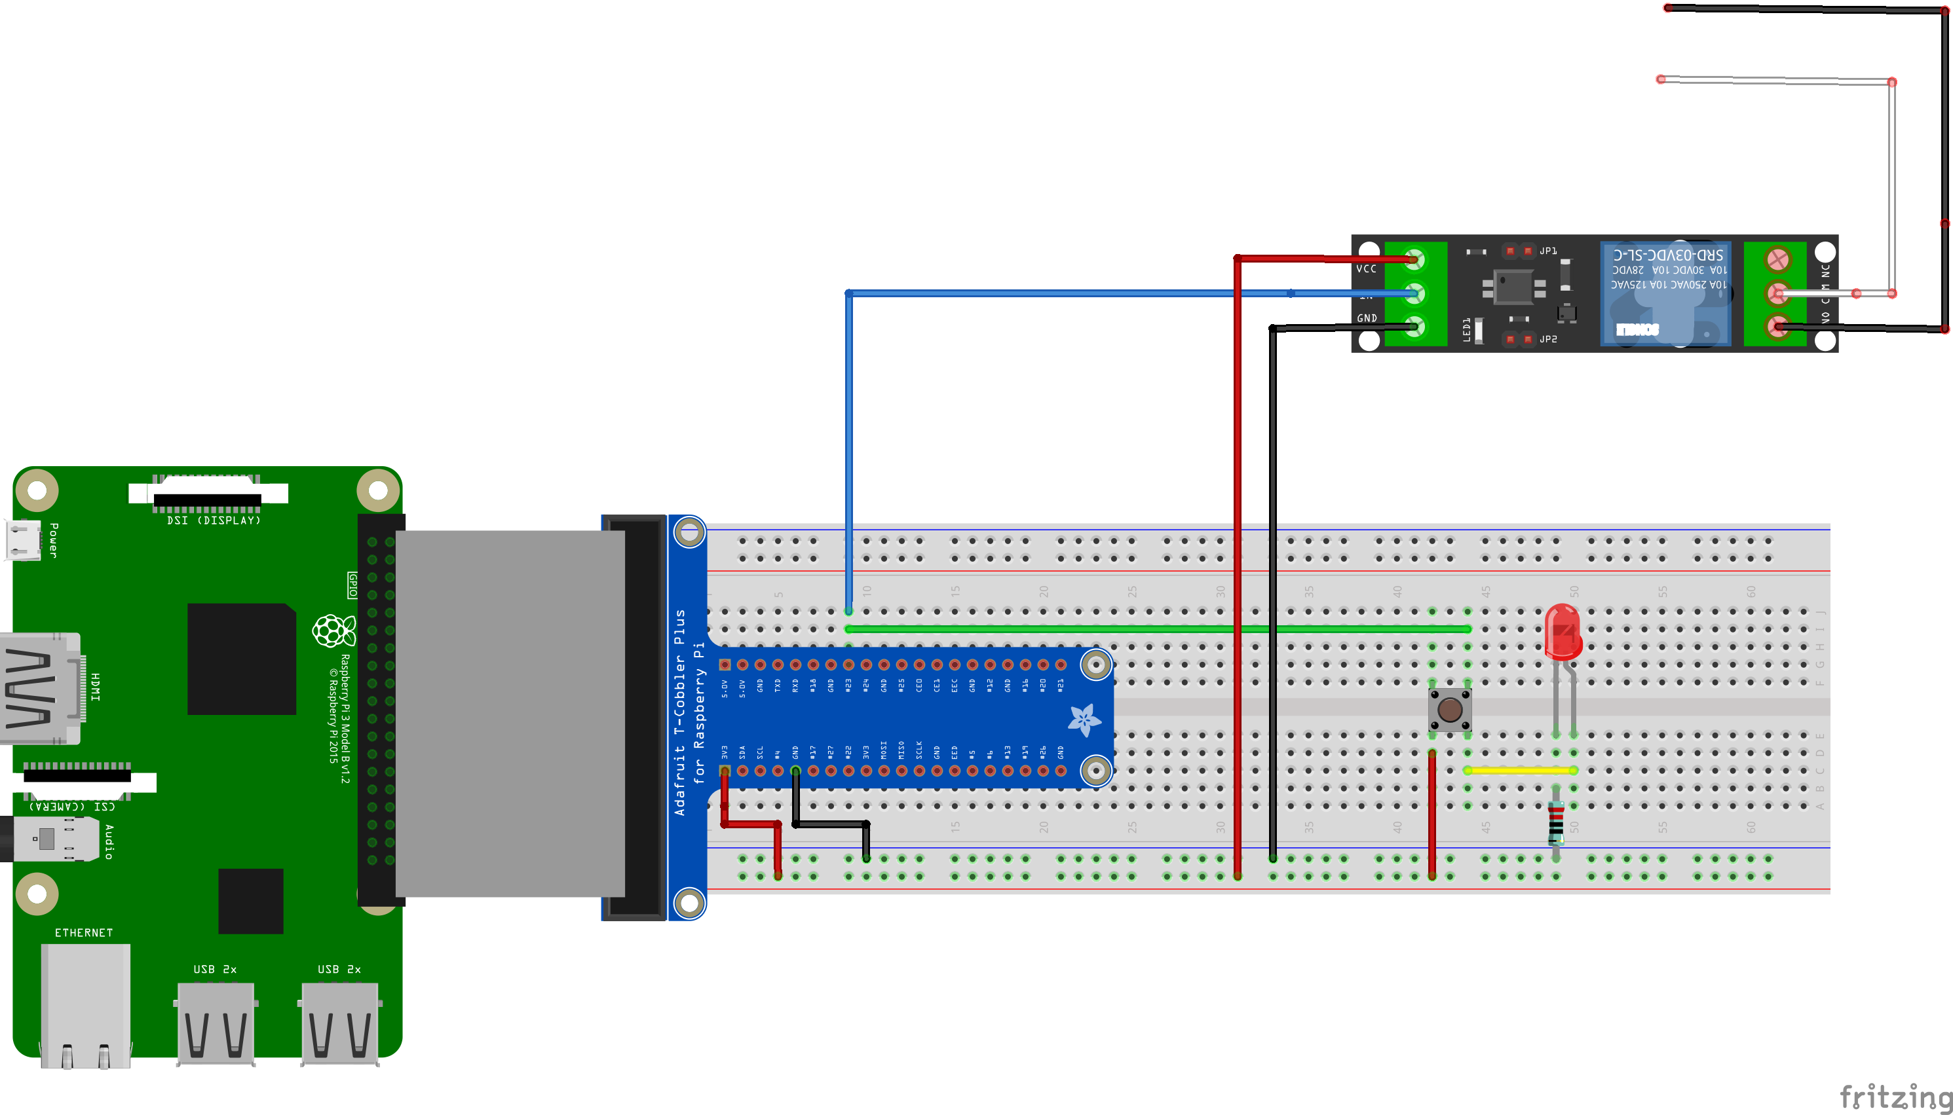
Hands-on Project: IoT “Smart” Lamp
MQTT over WebSockets
MQTT Broker
Publish in topic: Bulb/
Message: “on”/”off”
Subscribe to topic: Bulb/
Bulb/”on”
Bulb/”off”
Web app: (based on HTML 5 CSS and JavaScript)
Python
Backend
Python smart bulb logic running on RPi

Slide 8
Hands-On Project Breakdown
Build an IoT “Smart” Lamp Prototype using a Raspberry Pi and an ordinary desk lamp
Module 1:
Provision The Raspberry Pi for Use
Write the Raspberry Pi OS (operating system) Image and configure the services
Module 2:
Build the device: (hardware): an electronic circuit to connect the desk lamp to the Raspberry Pi
Module 3:
Implement the software (back-end and front-end) to enable the user to control the lamp using a web application
Use the standard IoT communication protocol (MQTT) protocol to enable the parts communicate.
https://mqtt.org/

Slide 9
Module 1: Provisioning the Raspberry Pi for Use
Write the operating system image: Raspberry
Configure services
Secure Shell (SSH)
raspi-config
I2C
Virtual Network Computing (VNC)
Install and Configure Mosquitto MQTT Broker
Linux Primer

Slide 10
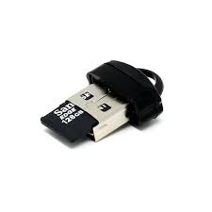
Install and Configure the Operating System (OS) and Services
Download and Install Raspberry Pi Imager
https://www.raspberrypi.com/software/
Insert micro-SD card into USB card reader and run the imager tool. See screen shots below

Slide 11
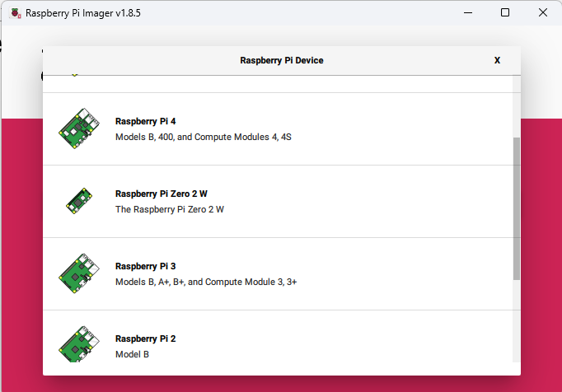
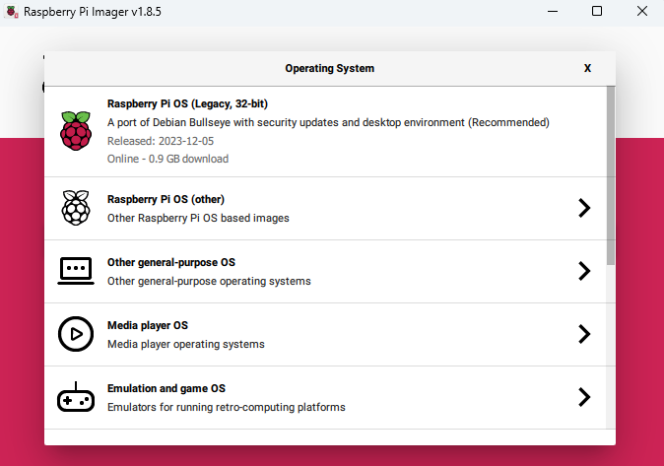
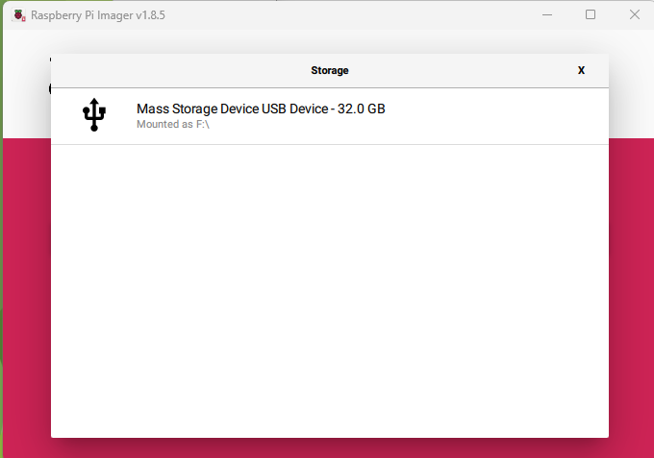
Select and Write the Operating System (OS) Image to the SD card
1. Raspberry Pi device: select your version (Pi 3)
2. Choose OS: Select Pi OS (32 bit) with desktop env.
3. Storage location: Select the micro- SD card from USB reader

Slide 12

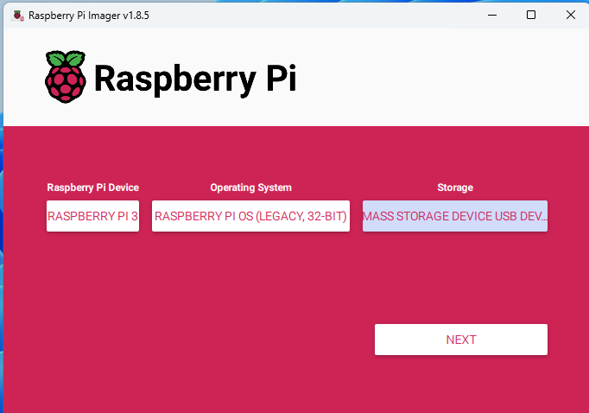
Before you proceed, Make sure….
1. Raspberry Pi 3 is selected
2. 32-bit Legacy OS w/ desktop environment
3. Make sure the micro-SD card is selected as the storage
* Only when 1,2, and 3 are verified, click “next”

Slide 13
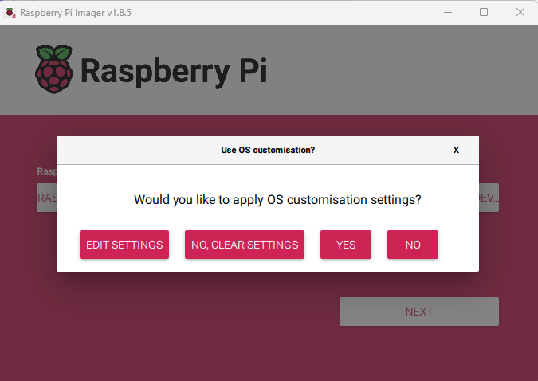
Customize the Settings:
Click “Edit Settings”

Slide 14
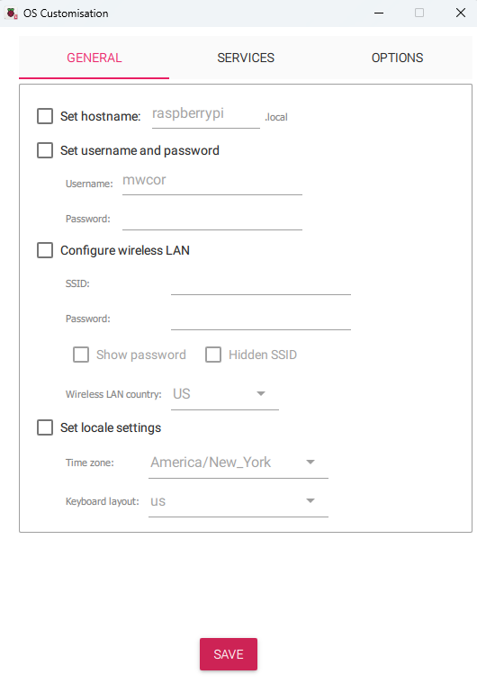
Important! Perform the next steps with the mentor
Follow the instructions as specified, or your Raspberry Pi will not be configured properly for the “smart’ lamp project
Proceed to the next slide to begin

Slide 15
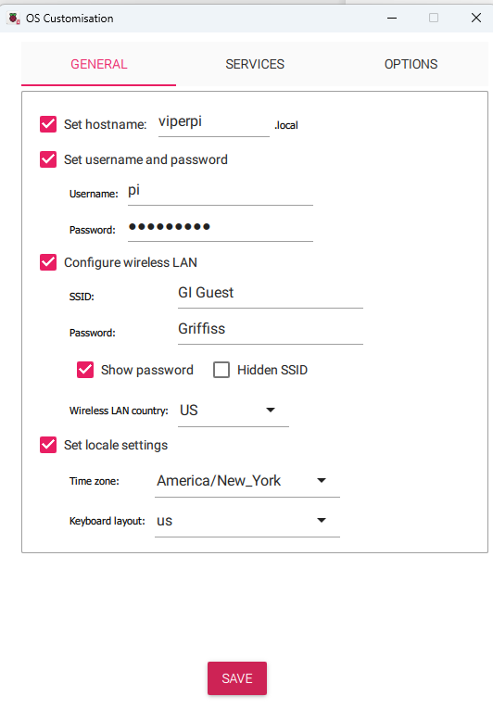
These settings must be as specified, or your Pi will not be properly configured for the project
Specify the hostname. Use your Team name with “pi” appended. For example, Team “Viper”, would use hostname “viperpi” as shown
Set the username to “pi” and the
Password to “team chooses” (don’t share)
Configure the WIFI settings to use the Griffiss institute Guest network.
Select the country to ‘US’ and set the locale settings as illustrated
Click “Save”

Slide 16
Customize the Settings:
Click “Edit Settings”

Slide 17
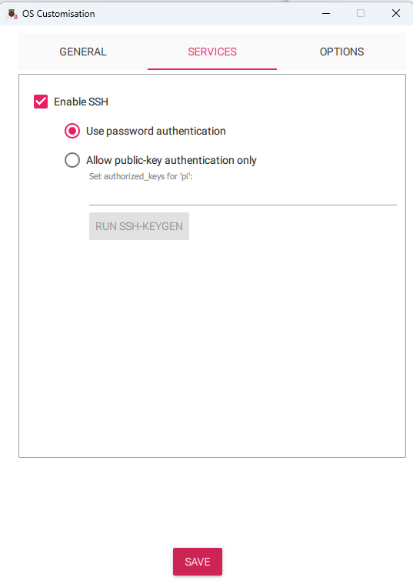
Enable Secure Shell
1. Click “Services” Tab
2. Choose password authentication
3. Save settings

Slide 18
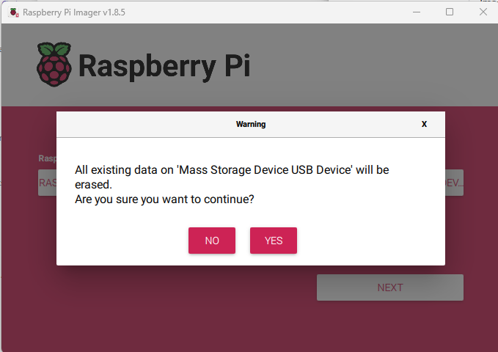
Customize the Settings:
1. Click “Yes”
2. Click “Yes” to write the operating system image

Slide 19
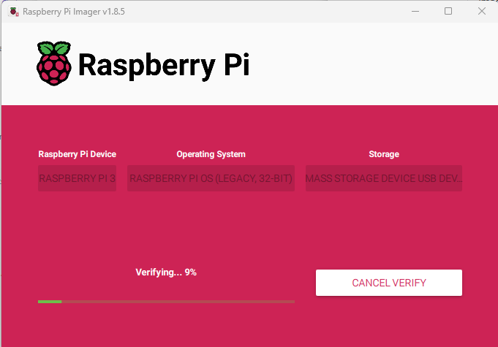
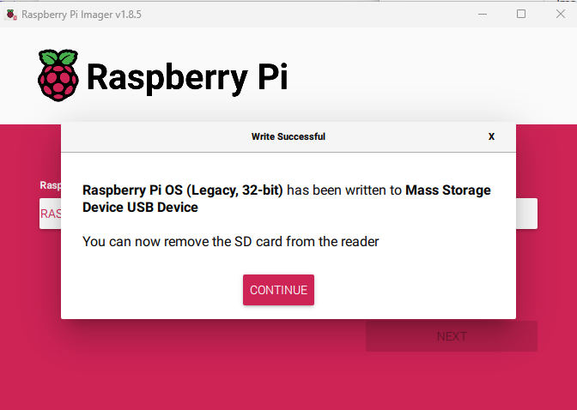
Wait for the OS image to be written to the SD-card

Slide 20
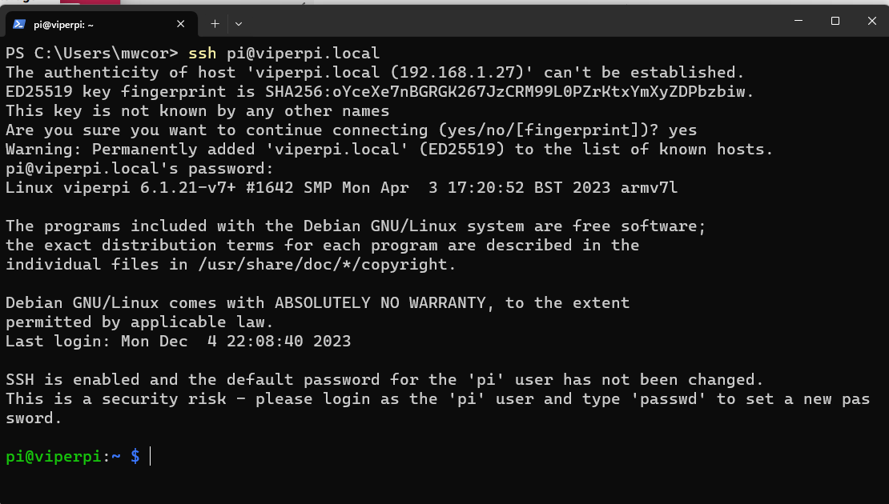
Start an SSH session with the Raspberry Pi
Open a new terminal window
Type command: pi@teamnamepi.local
Replace “teamname” with name of your Team
Example: Team “Viper”
ssh pi@viperpi.local
Type command: yes
Congratulations. You have a new (remote) connection to the Raspberry Pi

Slide 21
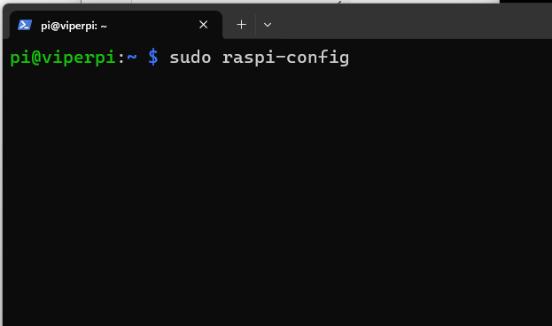
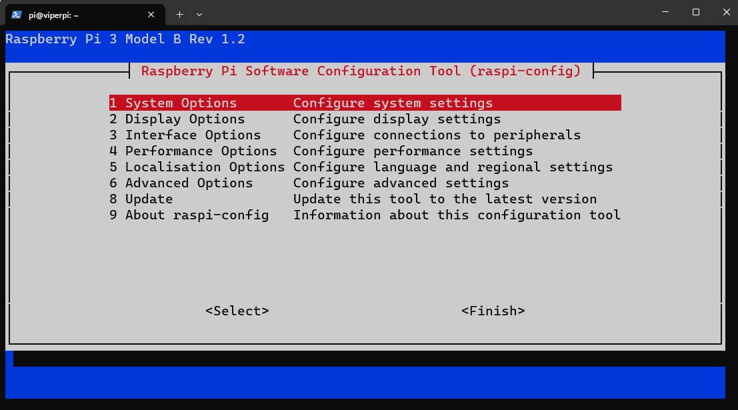
Run the Raspberry Pi configuration tool to configure the services
Type command: sudo raspi-config

Slide 22
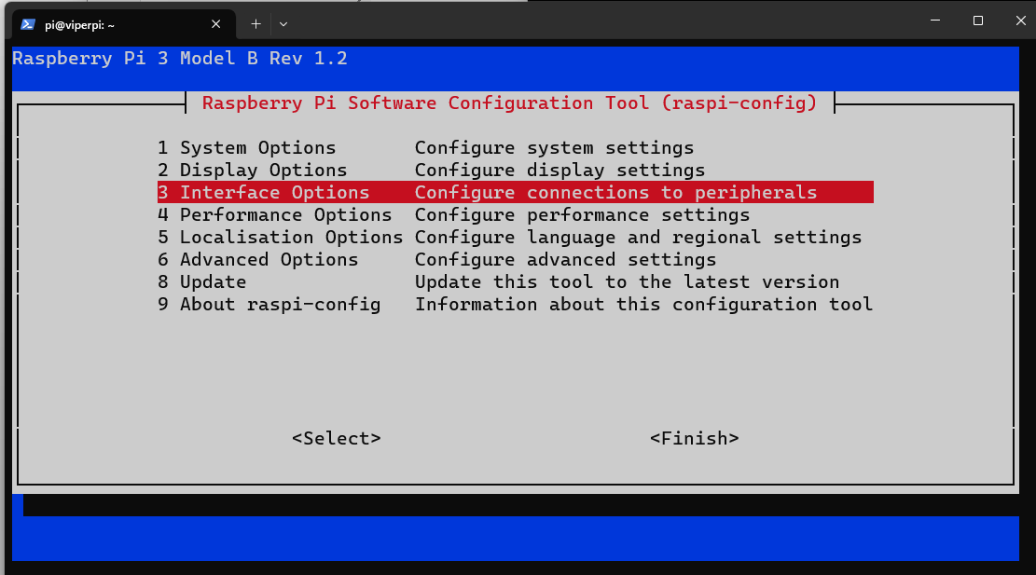
Select Configure the Interfaces:
Select menu item 3:

Slide 23
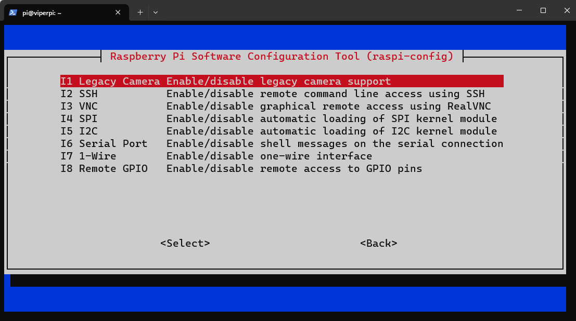
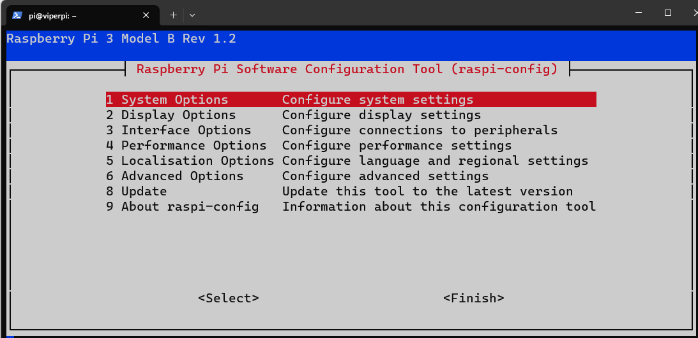
Enable SSH, VNC, and I2C
SSH is already enabled
Enable both VNC and I2C
I2C (Inter-Integrated Circuit) is widely used a serial bus protocol for establish serial communication integrated circuits (ICs)
Select Finish to exit

Slide 24
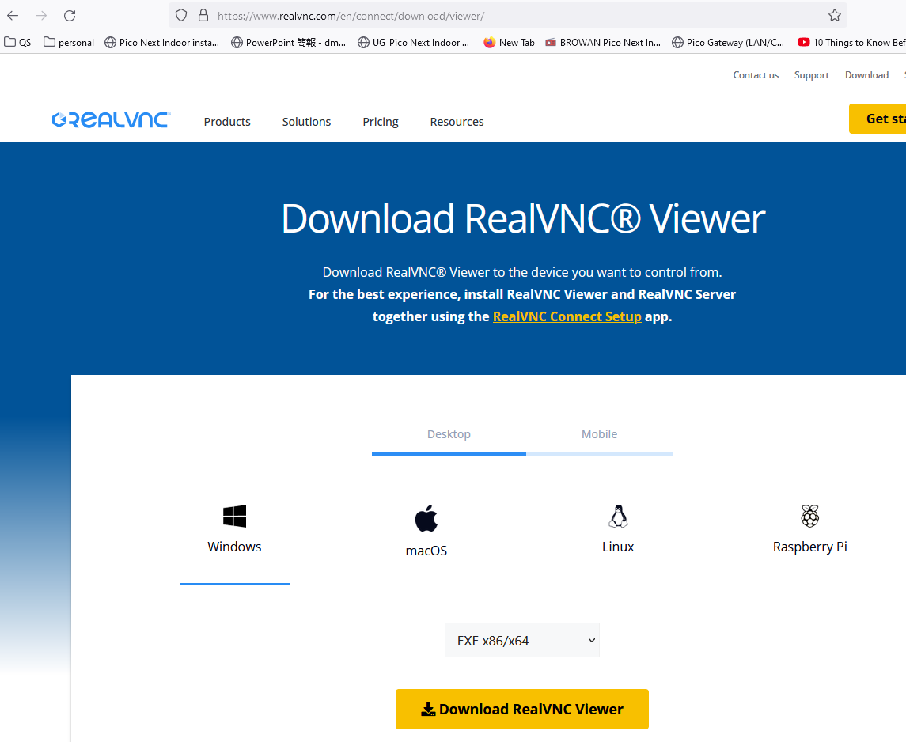
Setup VNC viewer laptop PC
VNC stands for Virtual Network Computing. It is a cross-platform screen sharing system that was created to remotely control/view another computer
Download the VNC viewer application to Windows (host) computer:
https://www.realvnc.com/en/connect/download/viewer/

Slide 25
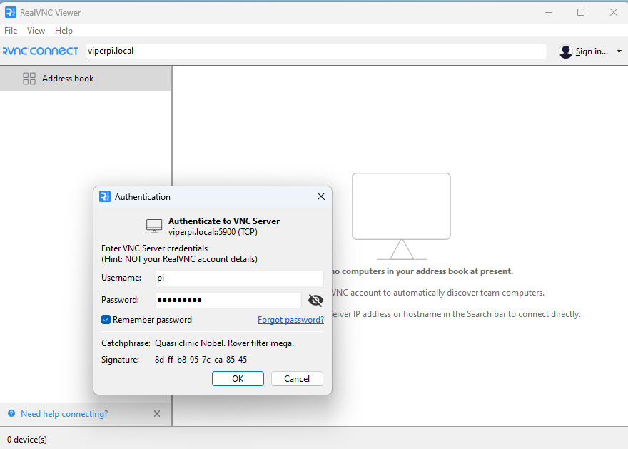
Establish a VNC session with Raspberry PI
Open the Real VNC viewer and enter the Raspberry Pi host name in the connect box.
recall the host have given should be the team's name followed by the keyword word “pi”.
For example, for Team “Viper”, the raspberry pi host name should be “viperpi.local”
Enter the hostname for your team’s pi in the Real VNC viewer connect box as shown and press
Supply the username “pi”, and the password your team specified.

Slide 26
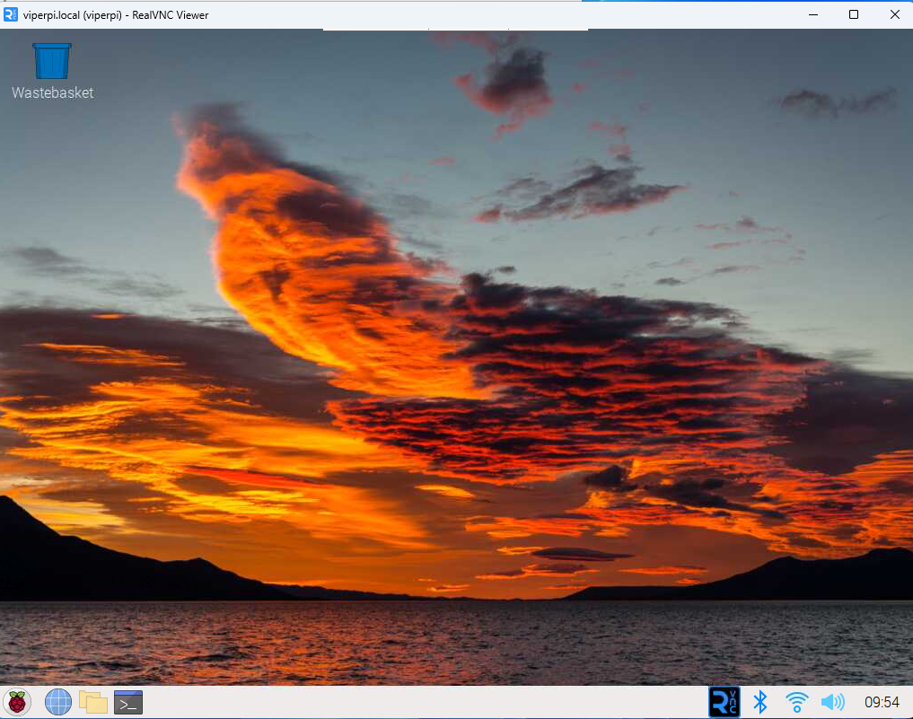
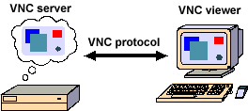
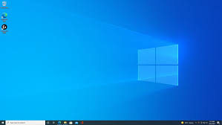
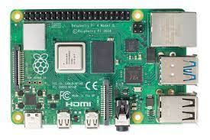
Example established VNC session Remote desktop experience, without the need for a physical monitor and peripherals
Questions / Recap ?
Source: http://web.mit.edu/cdsdev/src/howitworks.html

Slide 27
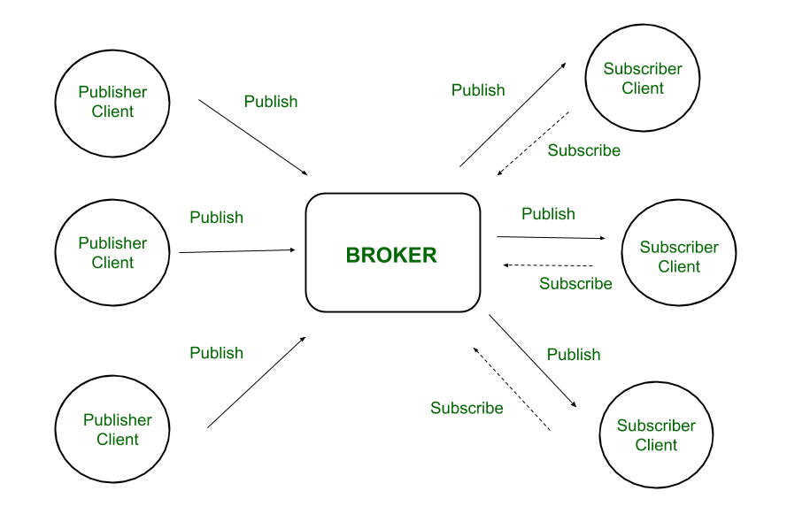
MQTT enables communication between the web (user) interface and the Raspberry PI device (the electronic circuit)
MQTT stands for Message Queuing Telemetry Transport) -is a simple messaging protocol, designed for constrained devices with low bandwidth. – [1]
perfect for exchanging data between IoT devices.
https://mqtt.org/
https://learn.sparkfun.com/tutorials/introduction-to-mqtt/all
https://www.geeksforgeeks.org/introduction-of-message-queue-telemetry-transport-protocol-mqtt/ - [1]
https://www.geeksforgeeks.org/fundamental-features-of-mqtt/
https://randomnerdtutorials.com/how-to-install-mosquitto-broker-on-raspberry-pi/
MQTT over web sockets (JavaScript) tutorial
http://www.steves-internet-guide.com/using-javascript-mqtt-client-websockets/
Source: https://www.geeksforgeeks.org/introduction-of-message-queue-telemetry-transport-protocol-mqtt/ - [1]

Slide 28
IoT “Smart” Lamp
MQTT Broker on RPi
Publish in topic: Bulb/
Message: “on”/”off”
MQTT over WebSockets
Subscribe to topic: Bulb/
Bulb/”on”
Bulb/”off”
Bulb Web app: (based on HTML 5 CSS and JavaScript)
Python
Backend
Python smart bulb logic running on RPi

Slide 29
Install Mosquitto MQTT Broker on Raspberry PI
Start an SSH session with the Raspberry Pi:
Open a command terminal
Enter command: ssh pi@{teamname}pi.local - replace {teamname} with corresponding team name: example Team: “Viper” → ssh pi@viperpi.local
From the ssh session, enter command:
sudo apt install -y mosquitto mosquitto-clients
To make Mosquitto auto start when the Raspberry Pi boots, you need to run the following command (this means that the Mosquitto broker will automatically start when the Raspberry Pi starts):
sudo systemctl enable mosquitto.service
Test the installation by running the following command:
mosquitto -v
Source: https://randomnerdtutorials.com/how-to-install-mosquitto-broker-on-raspberry-pi/

Slide 30
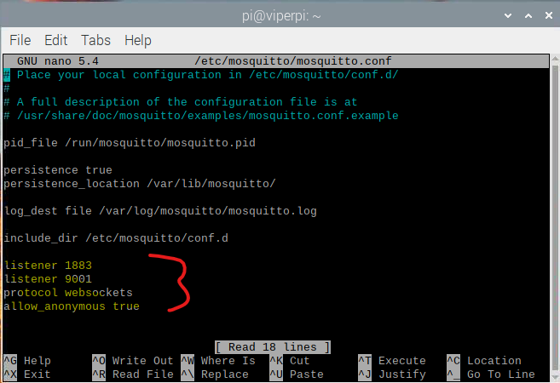
MQTT Broker configuration: WebSockets
Configure the MQTT Broker to use Web sockets
https://randomnerdtutorials.com/how-to-install-mosquitto-broker-on-raspberry-pi/
http://www.steves-internet-guide.com/mqtt-websockets/
Start (or use existing) SSH session with the Pi
Use nano or vi to open the configuration file: sudo nano /etc/mosquitto/mosquitto.conf
Append the highlighted configuration and save
Restart the service: sudo systemctl restart mosquitto
listener 1883
listener 9001
protocol websockets
allow_anonymous true

Slide 31
Interlude: Short Linux Primer
Wait! Isn’t this camp about Raspberry Pi? Why are we pausing to talk about Linux?
Ans: Linux is an operating system that runs almost everywhere! In almost all IT technical careers, you will be required to know and use Linux with proficiency.
Linux runs in more environments than you may realize:
Big enterprise datacenters, Cloud service backends, your Android phone, smart TVs, cameras, wearables (smart watches), etc.
And yes… it is the default OS that runs on your Raspberry PI.
Called Raspberry Pi OS (based on the Debian GNU/Linux distribution )
https://en.wikipedia.org/wiki/Raspberry_Pi_OS
Reasonable (Funny) Video Intro to Linux
https://www.youtube.com/watch?v=zA3vmx0GaO8

Slide 32
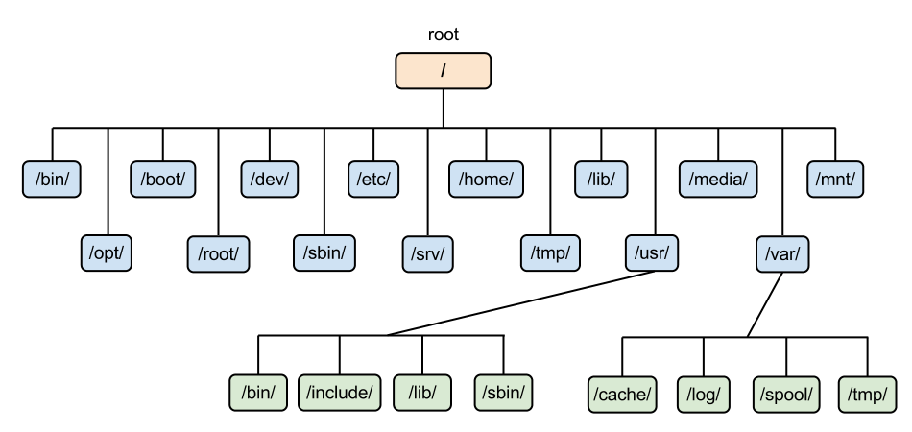
Linux Command Line
Shell - CLI - primer user interface to operating. Its essentially a program interprets user commands, and run other programs
Understanding the Filesystems
Files and folders (called directories), and are organized hierarchically (in a tree structure)
Basic Linux Commands (video)
https://www.youtube.com/watch?v=bb_ApuH15YE
Further study reference: “The Linux Command line” ebook
https://linuxcommand.org/tlcl.php
ls – list contents of folder
~ refers to home folder
cd – change to new directory (folder)

Slide 33
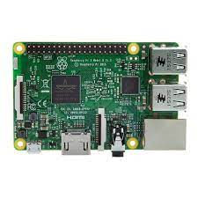
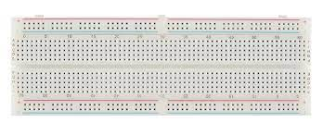
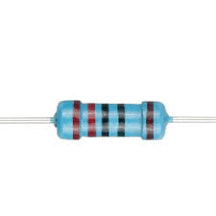
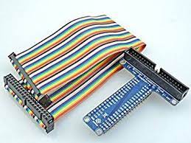
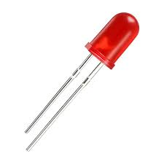
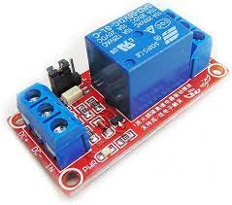
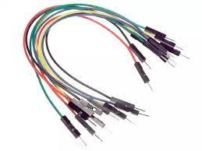
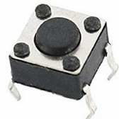
Module 2: Prototyping the IoT “Smart” lamp device
The “smart” lamp hardware is implemented as a simple electronic circuit, consisting of the following components:
List of components:
1 x Raspberry Pi 3B
1 x full size bread board
1 x 40-pin ribbon cable
1 x T-cobber (GPIO extender)
2 x 220 Ohm resistor
2 X 5mm LED
1 X 5v 1 channel relay
Jumper wires
Switch button

Slide 34
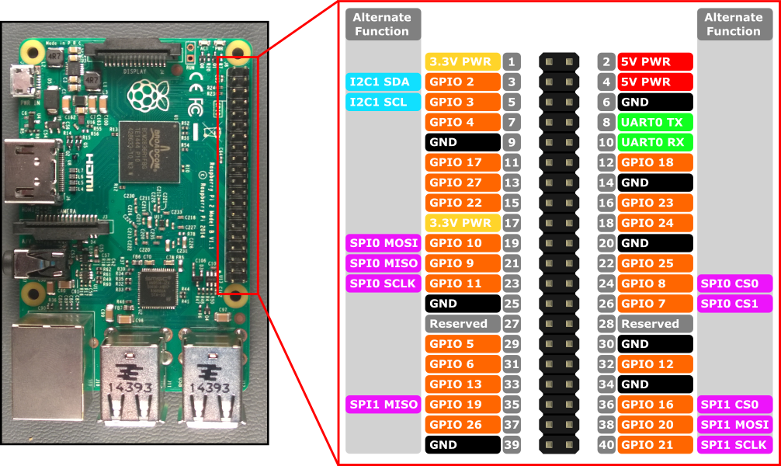
40-pin GPIO (General Purpose Input/Output) Header Overview
Allows the code running on Raspberry PI to interface with the outside world…
Supports digital communication with external devices (the outside world) using serial bus protocols including: UART, SPI, i2c
Does NOT support analog inputs
We can easily fix by connecting an analog-to-digital converter (ADC)
40-pin GPIO header
Pin numbering: Board, BCM/GPIO/WiringPi
https://learn.sparkfun.com/tutorials/introduction-to-the-raspberry-pi-gpio-and-physical-computing/gpio-pins-overview
https://www.raspberrypi-spy.co.uk/2012/06/simple-guide-to-the-rpi-gpio-header-and-pins/
https://projects.raspberrypi.org/en/projects/physical-computing/1

Slide 35
Brief Review of Electronic Components

Slide 36
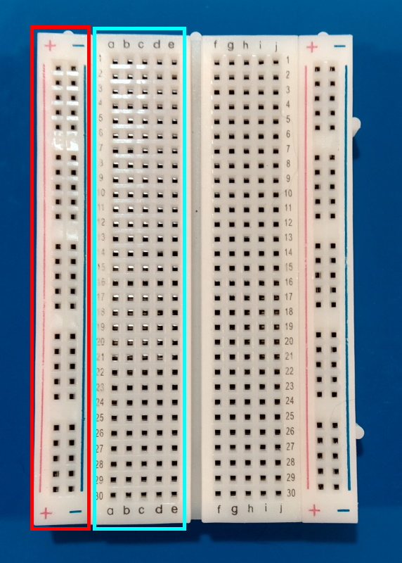
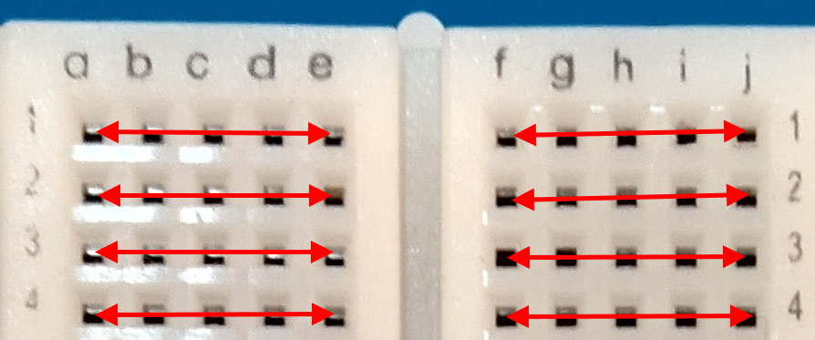
Breadboard
The breadboard is organized in rows and columns called socket strips (shown in cyan)
Socket strips are connected vertically
The bus strips on the edges (shown in red) are using connecting a power source (3.3v and 5v for the Pi)
Edge strips connect horizontally over the length of the breadboard
Socket strips allow components to be connected without soldering or wires. [2]
Source: https://learn.microsoft.com/en-us/training/modules/create-iot-device-dotnet/2-construct-iot-hardware - [2]
Any pin plugged into row 1, column ‘a’ would be connected to any pin plugged into row 1, columns ‘b-e’.
On the other side of the divider, row 1 columns f-j are similarly connected. [2]

Slide 37
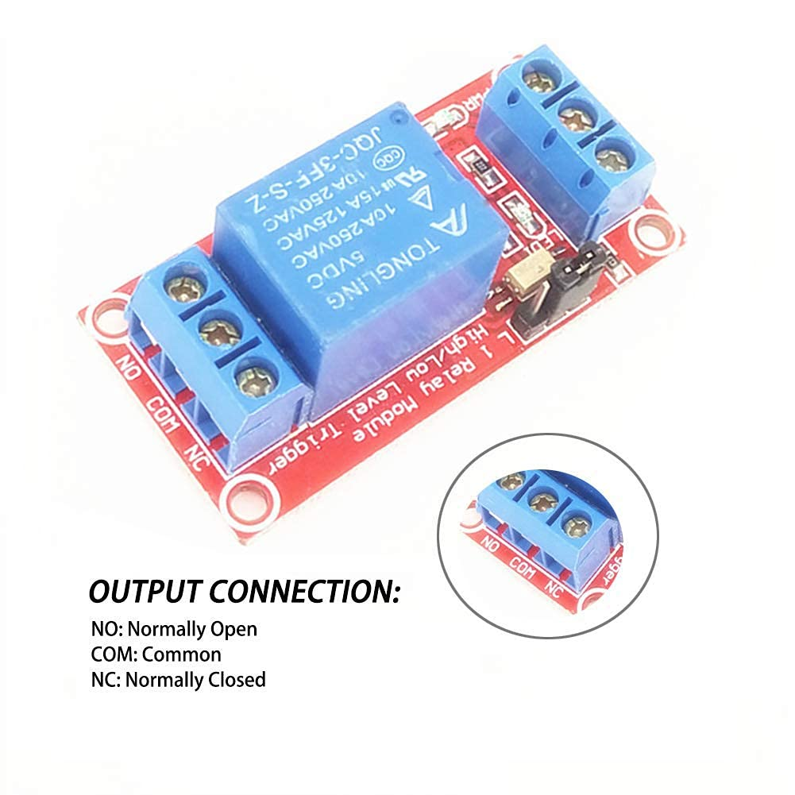
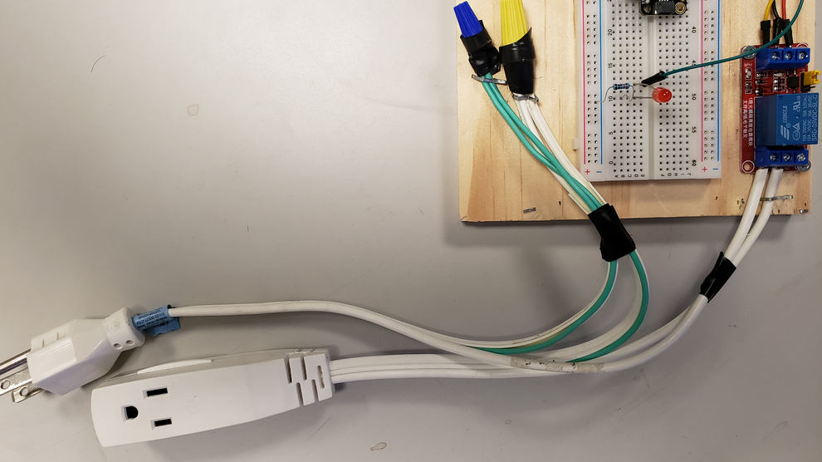
5v Relay Board Relay Module 1 Channel
An electromagnetic switch used to programmatically activate/deactivate external devices (i.e., a desk lamp or fan).
Use a small current to control separate (often larger) current.
When a small current is passed through the low-voltage (5v DC) input on the relay it activates the switch (using a coil) and completes the separate high voltage (120v AC) circuit (i.e., a larger current).
This is one way we how can control external devices: fans, desk lamps

Slide 38
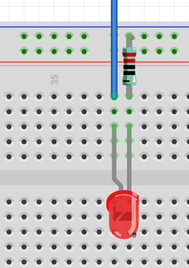
Resistor
Use of 220 Ohm resistor to limit the current through the LED and to prevent excess current that can burn out the LED
A resistor is a passive two-terminal electrical component that implements electrical resistance as a circuit element. In electronic circuits, resistors are used to reduce current flow, adjust signal levels, to divide voltages – [3]
[3] - https://en.wikipedia.org/wiki/Resistor

Slide 39
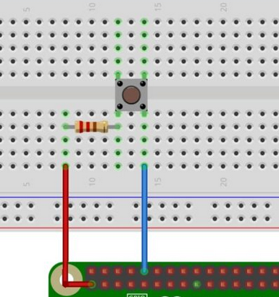
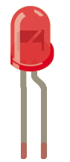
LED and Button Switch
The longer leg (known as the ‘anode’), is always connected to the positive supply of the circuit. The shorter leg (known as the ‘cathode’) is connected to the negative side of the power supply, known as ‘ground’.
LED stands for Light Emitting Diode, and glows when electricity (current) is passed through it. - [2]
Connect one side of the switch to an input pin on the Raspberry Pi, in this case we use pin 10.
The other side of the switch we connect to 3.3V on pin 1 using a resistor.
The resistor is used as a current limiting resistor to protect our input pin by limiting the amount of current that can flow. [3]
Source: https://thepihut.com/blogs/raspberry-pi-tutorials/27968772-turning-on-an-led-with-your-raspberry-pis-gpio-pins - [2]
Source: https://raspberrypihq.com/use-a-push-button-with-raspberry-pi-gpio/ - [3]

Slide 40
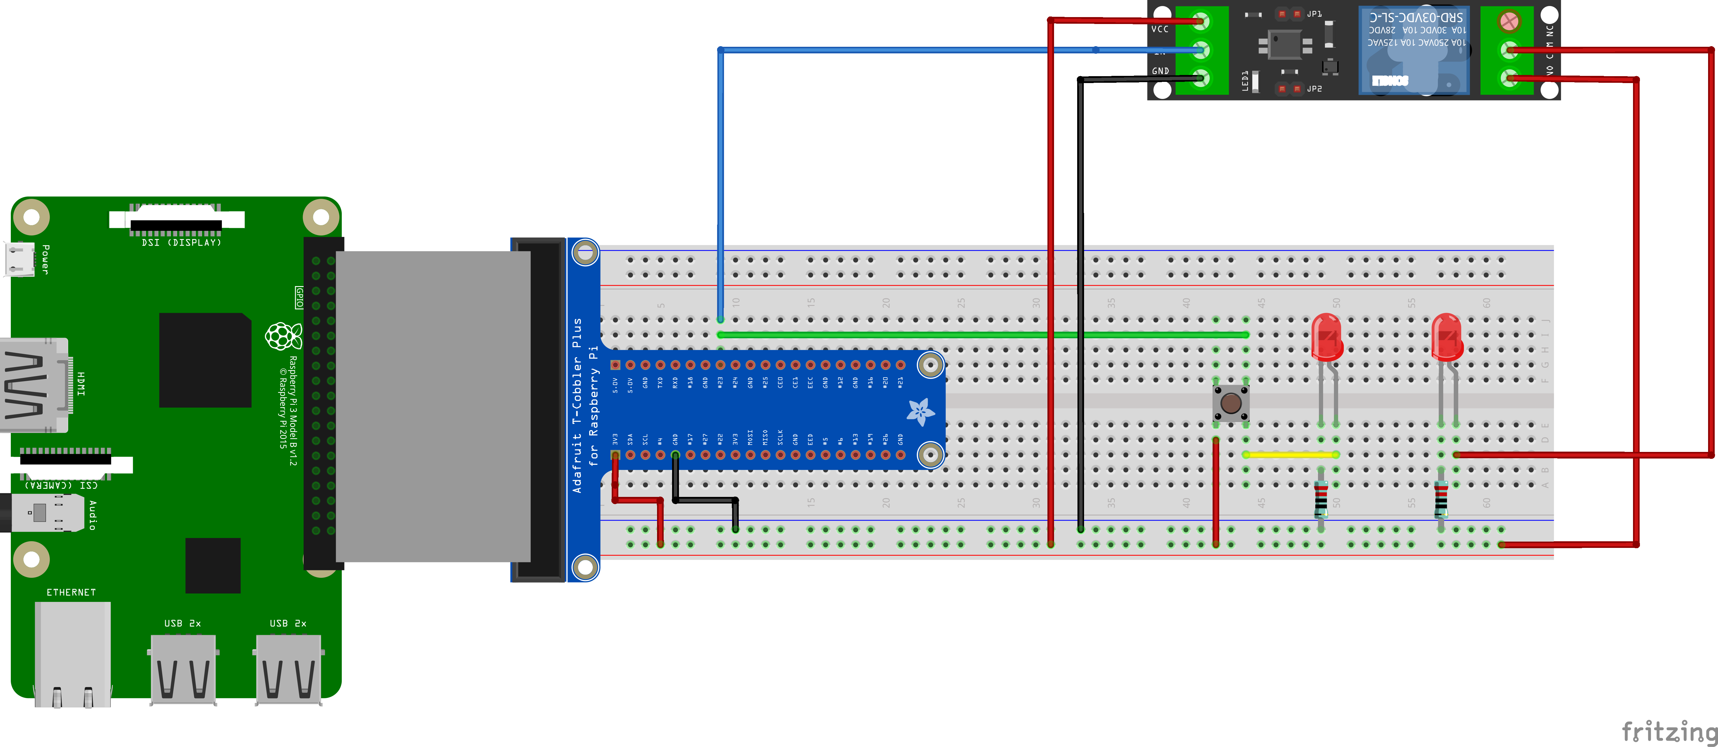
“Smart” lamp device (Fritzing circuit design) concept
Fritzing is an open-source hardware initiative that makes electronics accessible as a creative material for anyone.
https://fritzing.org/

Slide 41
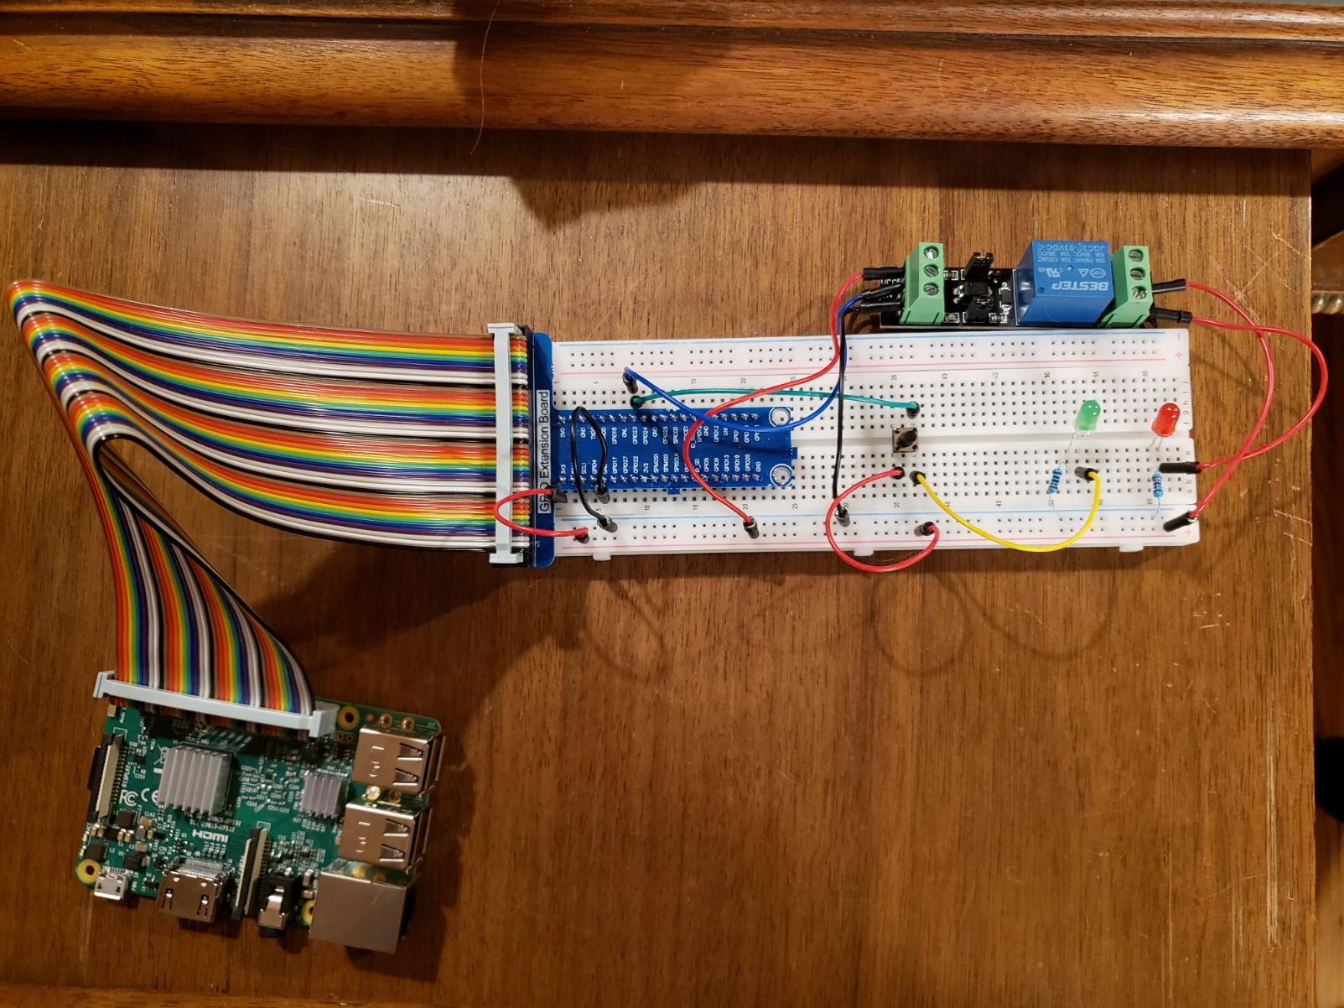
Completed “Smart” la device (completed prototype)

Slide 42
“Smart” lamp device (concept versus prototype)
versus

Slide 43
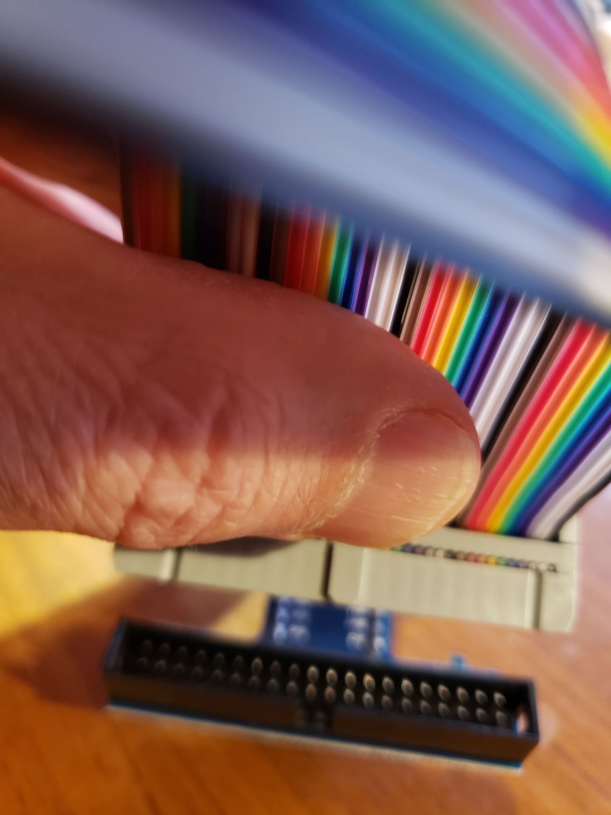
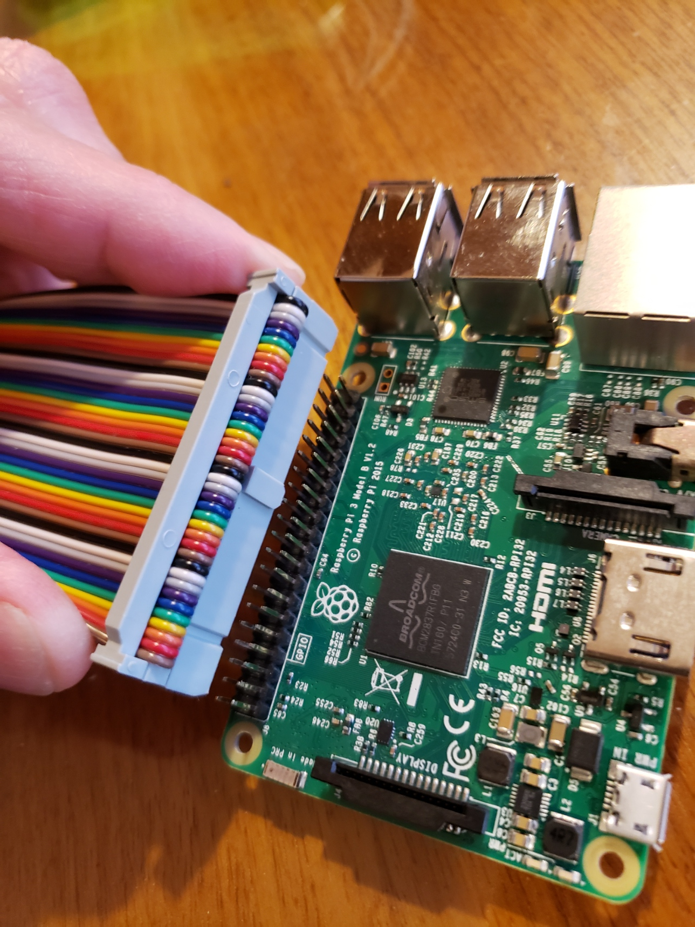
Properly Attaching the Ribbon Cable between the Raspberry Pi and the T-Cobbler
Align the notch on the ribbon cable with the t-cobber
Connect the ribbon cable so it does not cross over the Raspberry Pi (as illustrated)
* Carefully align the ribbon cable to connect all 40 pins of the GPIO header.

Slide 44


Attach the T-Cobbler to the breadboard
* Note of the rows on exposed on each side of the t-cobbler (3 on one side, and 2 on the other. Your design should look like this too.
3 rows of sockets visible
2 rows of sockets visible
** Note the orientation to negative/positive (power) terminal strips
*** Insert the t-cobbler beginning in the first column of sockets in the breadboard

Slide 45
Construct the device (electronic circuit):
Power off and disconnect the Raspberry Pi power source
Connect a “Red” jumper wire to the 3.3v pin of the T-Cobber and the positive (+) terminal strip of the breadboard (same side as the 3v pin). This provides 3.3v power to entire edge terminal socket strip designated by the red line
Connect a “Black” jumper wire to a “GND” pin on 3.3v side of the T-Cobbler, and the negative (-) terminal strip on the breadboard (same side 5v pin). This provides a ground (-) to the entire edge terminal socket strip designated by the blue line
Push a switch button onto the bread board (as shown). Connect an “Green” wire to GPIO 23 from the T-cobbler to the output side of the button
Connect “Red” wire from the positive (+) 3.3v terminal strip of the breadboard to the input side of the switch button
Push an LED into the breadboard (as shown). Note: the bend in the LED terminal indicates the longer (+) LED anode. Connect a 220-ohm resistor between LED cathode (shorter negative - ) pin and the negative (-) terminal strip on the breadboard
Connect a “Yellow” wire from the output side of the switch button to the longer (+) LED anode terminal of the LED
Push an LED into the breadboard (as shown). Note: the bend in the LED terminal indicates the longer (+) LED anode. Connect a 220-ohm resistor between LED cathode (shorter negative - ) pin and the negative (-) terminal strip on the breadboard
Connect a “Blue” jumper wire to the GPIO pin 23 from the T-cobbler, and the IN terminal of the 3.3v 1 channel relay
Connect a “Red” jumper wire from 3.3v positive (+) terminal strip of the breadboard to VCC terminal on of the relay
Connect a “Black” jumper wire from negative (+) terminal strip of the breadboard to GND terminal on of the relay
Connect a “Red” wire to the NO (Normally open) terminal of the relay to the 3.3v (positive +) terminal strip of the breadboard
Connect “Red” wire the COM (Common) terminal of the relay to the (positive +) terminal of the LED
9.
12.
8.
3.
10.
*5.
*7.
4.
6.
11.
1.
2.
* - indicates multiple steps
Connect and power on Raspberry Pi and test by press the button to activate the bulb

Slide 46
Module 3: Implement the “Smart” Lamp Controller Software
Implement the back-end to control the lamp
Implement the front-end user interface
MQTT / Web sockets
MQTT Broker on RPi
Publish in topic: Bulb/
Message: “on”/”off”
Subscribe to topic: Bulb/
Bulb/”on”
Bulb/”off”
1. Smart Bulb Web app: (based on HTML 5 CSS and JavaScript)
Python
Backend
2. Python smart bulb logic running on RPi

Slide 47


Download the smart bulb source code from GitHub: https://github.com/mwcorley79/smartbulb
Choose “Code”→”Download Zip”, and save the zip to the “Desktop” folder on the laptop
Navigate to Desktop, and right-click the zip file, and choose extract all

Slide 48

Project structure: navigate to the extracted folder to view the project files
smart_bulb.html – This is front-end html user (web) interface app
smart_bulb.py – This is the back-end Python script that runs on the Raspberry Pi
interfaces with the GPIO header to control the desk lamp

Slide 49

Install Visual Studio Code (VSCode) Editor
VSCode is the most popular software development code editor available today.
Typically, the software for the Raspberry Pi is developed using a development host (your windows laptop), equipped with development tools including: VSCode, Python interpreter, debuggers, and potentially device simulators etc.)
Software is typically developed and tested incrementally
The resulting software artifacts are moved from the dev host to the Raspberry Pi (sometimes referred to as the target device).
Debuggers help with development
Note: although development can be performed directly on the Raspberry Pi, it is more often performed on the development host
Download and install Visual studio code for Windows:
https://code.visualstudio.com/download

Slide 50



Opening the Project in VSCode
Navigate to the Desktop
Double click the VSCode icon to start the editor
Choose “Open Folder”, select the project folder, and click “Select Folder”

Slide 51

The back-end (Python) code in VSCode: smart_bulb.py
The back-end (Python 3) script runs on the Raspberry Pi to control the desk lamp
We need to copy smart_bulb.py to the Raspberry Pi using secure copy (SCP)
Controlling the lamp requires logic that uses
Paho MQTT library to connect to the broker using MQTT over web sockets
subscribes to the “bulb” topic, and receives “on” / “off” messages
Message processing logic uses a GPIO access library to interface with of the desk lamp by controlling the relay switch
Take a few mins to review this code

Slide 52

Create folder on the Raspberry Pi to store smart_bulb.py
Open windows terminal and start an SSH session with Raspberry Pi:
Enter command: ssh pi@{teamname}pi.local - replace {teamname} with corresponding team name:
Example Team: “Viper” → ssh pi@viperpi.local
Create a new destination folder to store the smart_bulb.py script
mkdir ~/smartbulb
You can type exit to terminate the SSH session, but leave it active, we will continue to use it in the next steps

Slide 53


Use Secure (SCP) to copy smart_bulb.py to Raspberry Pi
Navigate to the project folder, right-click, and choose “Open in terminal”
Type the following command:
scp .\smart_bulb.py pi@teamnamepi.local:~/smartbulb
This copies smart-bulb.py to the Raspberry Pi destination folder created in the previous step: ~/smartbulb
Replace pi@{teamname}pi.local - with corresponding team name:
Example Team: “Viper” → pi@viperpi.local
Example:

Slide 54



Install the Python dependencies required to run smart_bulb.py
Return to active SSH session with the Raspberry Pi (or start a new session)
Navigate to the folder created previously for storing the smart_bulb.py
Enter command: cd ~/smartbulb
Verify the smart_bulb.py was successfully transferred by entering command: ls –l
The IoT smartbulb project was developed to be compatible with Python 3.9 and later:
Verify Python 3 is preinstalled on the Raspberry Pi
python –version
Install Paho MQTT Client package library
pip3 install "paho-mqtt<2.0.0"
Note: Version 2.0.0 of the library was released in February 2024; and contains breaking changes so the above installs v1
Install Python module to control the GPIO: RPi.GPIO
pip3 install RPi.GPIO

Slide 55

Back-end: smart_bulb.py (functional concept)
MQTT Broker
To Run the back-end, enter command:
python ./smart_bulb.py
WebSocket
(port 9001)
Subscribe to MQTT
topic: Bulb/
Relay (Lamp) signal on / off
Messages:
”on”, ”off”
smart_bulb.py
Note: It is important to start the back-end code and leave it running, else the front-end (user interface) will not function.
Paho MQTT client
RPi.GPIO

Slide 56



Front-end user interface (HTML/JS) code in VSCode: smartbulb.html
The web interface allows the user to toggle a slider switch button that simulates turning a lamp on and off .
Uses MQTT over WebSockets to control the operation of a desk lamp

Slide 57


Front-end user interface (HTML/JS) code: smartbulb.html
Smartbulb.html is developed using a combination web technologies: HTML 5, CSS , and JavaScript
Find the variable “host” on line 105
Replace the value: “[ip-address]” with the IPv4 address of the Raspberry Pi and save the file.
To find the IP address, open a terminal and SSH to the Raspberry Pi
run the following command: ifconfig
The ip address is shown under the wireless network interface (wlan0)
Change line 105 to the IP address issues to the Pi.
For Example:
let host = “192.168.1.10”
Save the file
A JavaScript library is used to establish MQTT connectivity with an MQTT Broker over Websockets

Slide 58


Serve up the user interface in a browser such Chrome or Firefox
Open a browser, navigate to the smartbulb project folder and open smartbulb.html

Slide 59


Test the Smart bulb: Make sure the back-end: smart-bulb.py is running
Enter Team name and click “submit”
Front-end user interface (HTML/JS) code in VSCode: smartbulb.html
Toggle the light switch on/off to control the light bulb

Slide 60
Challenge Questions, for fun…
Can you change your front-end code, so it controls the instructor’s desk lamp at the front of the room?
You’ll need one piece of the information to accomplish this.
Can you modify your front-end code to control another team’s lightbulb?
Would you say that your IoT desk lamp implementation meets a reasonable level of security? Why or why not?
Notice (on line 28) that your back-end code (smart_bulb.py) connect to the MQTT over local host (127.0.0.1) .
Explain what local host is?
Why can your back-end code connect to MQTT over local host?
5. The front-end (user) interface is developed using HTML 5/ CSS. Do you think you can change the background color (or other visual aspects) of the user interface?
6. What was your most surprising discovery about the about Raspberry Pi after completing the smart lamp project?

Slide 61



Raspberry Pi Edge Processing : (Artificial Intelligence Image Recognition Demo) (Time Permitting)
HTTP-REST
Object Classifier (REST) Service
Object Classifier (External) Client – running on Windows 11

Slide 62
Where do we go from here?
Other STEM camps
Online based learning resources
https://randomnerdtutorials.com/getting-started-with-raspberry-pi/
Let's Learn .NET - IoT (Internet of Things) (youtube.com)
High school course work
Computer Science/Programming/Cyber security offered
College careers
Computer Science, Computer/Electrical Engineering
Speak to your teachers/guidance counselors
Reach out to us, anytime!

Slide 63
That’s all Folks
Please!! Please!!
Complete the Survey for issued by the Griffiss Institute staff
Thank you for joining us for Pi Day!!

